Slide 1

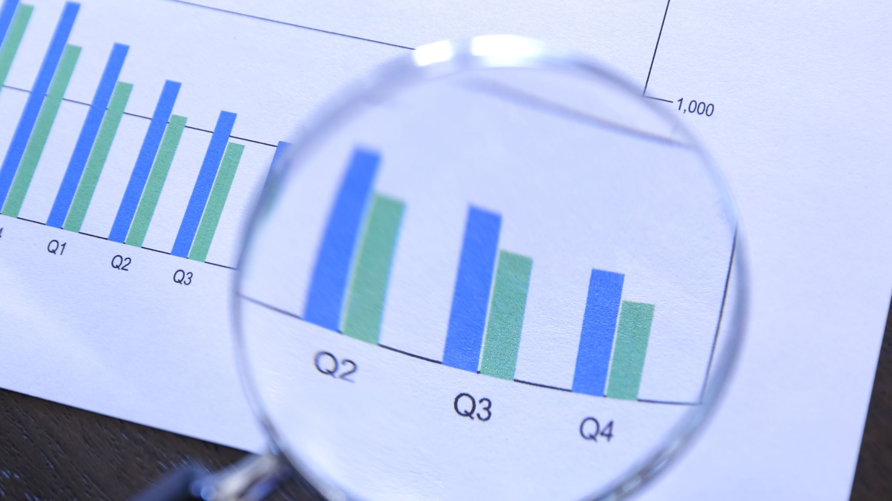
BlackRock Investment Analysis
Weekly status report 7

Slide 2
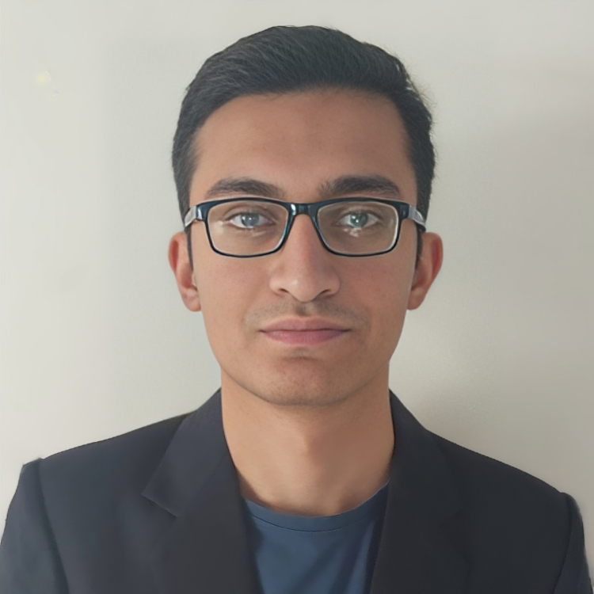
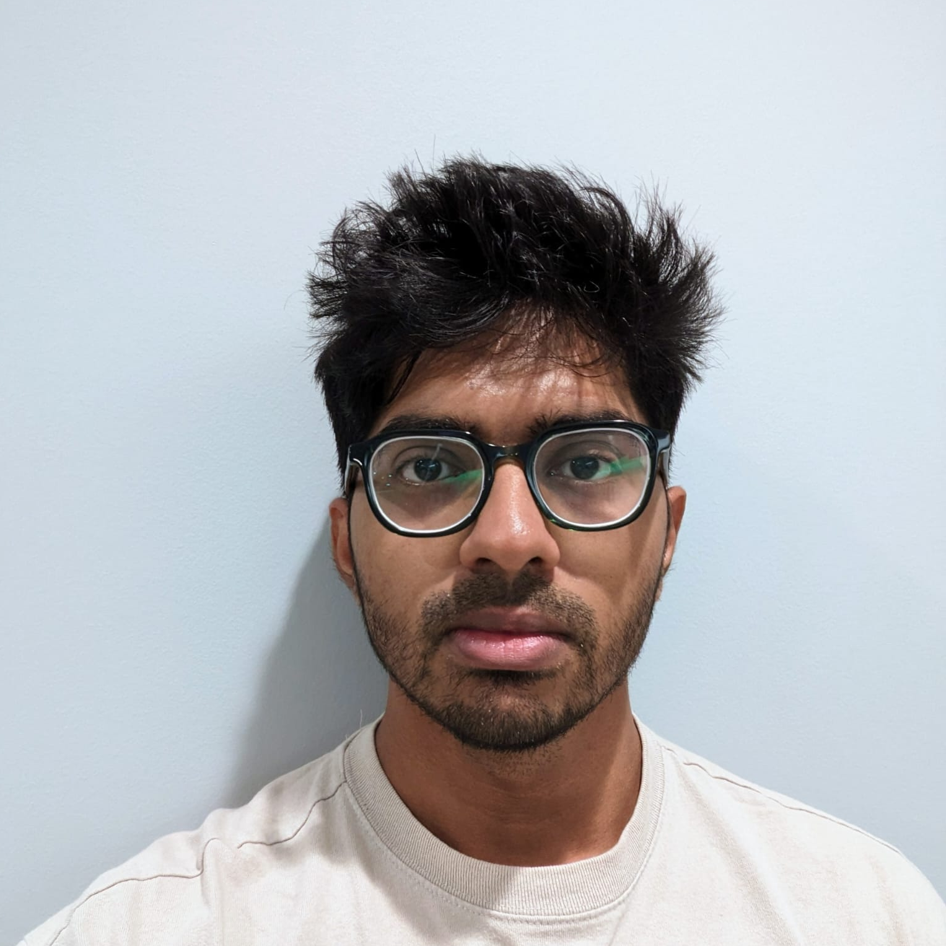
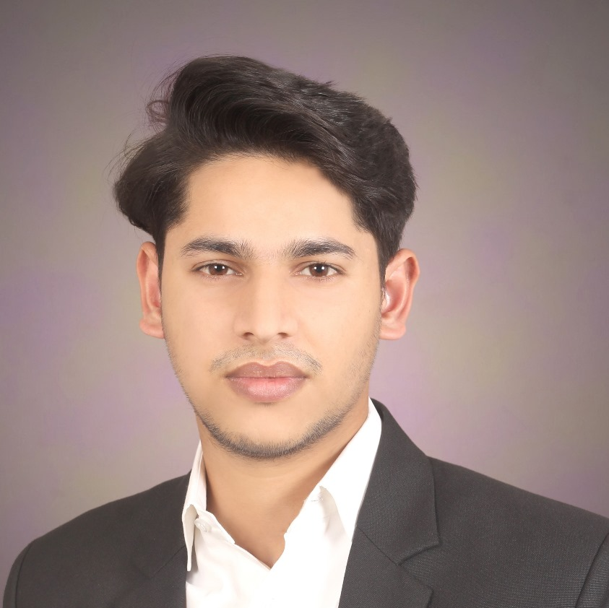
Team Members
Aryan Radadiya
Developer
Joyson Gonsalves
Team Lead
Sumit Kumar Pandey
Data Analyst

Slide 3
Date of Report: 4th March 2024
Date of Last Report: 20th February 2024
Prepared By: Group 7
Project Status: On Track

Slide 4

Activities Since Last Report
Issues or Challenges encountered this week:
Implementing Clustering algorithm.
What was done to overcome them:
We are searching for references and understanding how the machine learning model works.
We tried few different codes.

Slide 5
Activities Since Last Report
Task completed this week:
Implemented the machine learning algorithm (Cluster Algorithm).
Started designing the visualization.

Slide 6

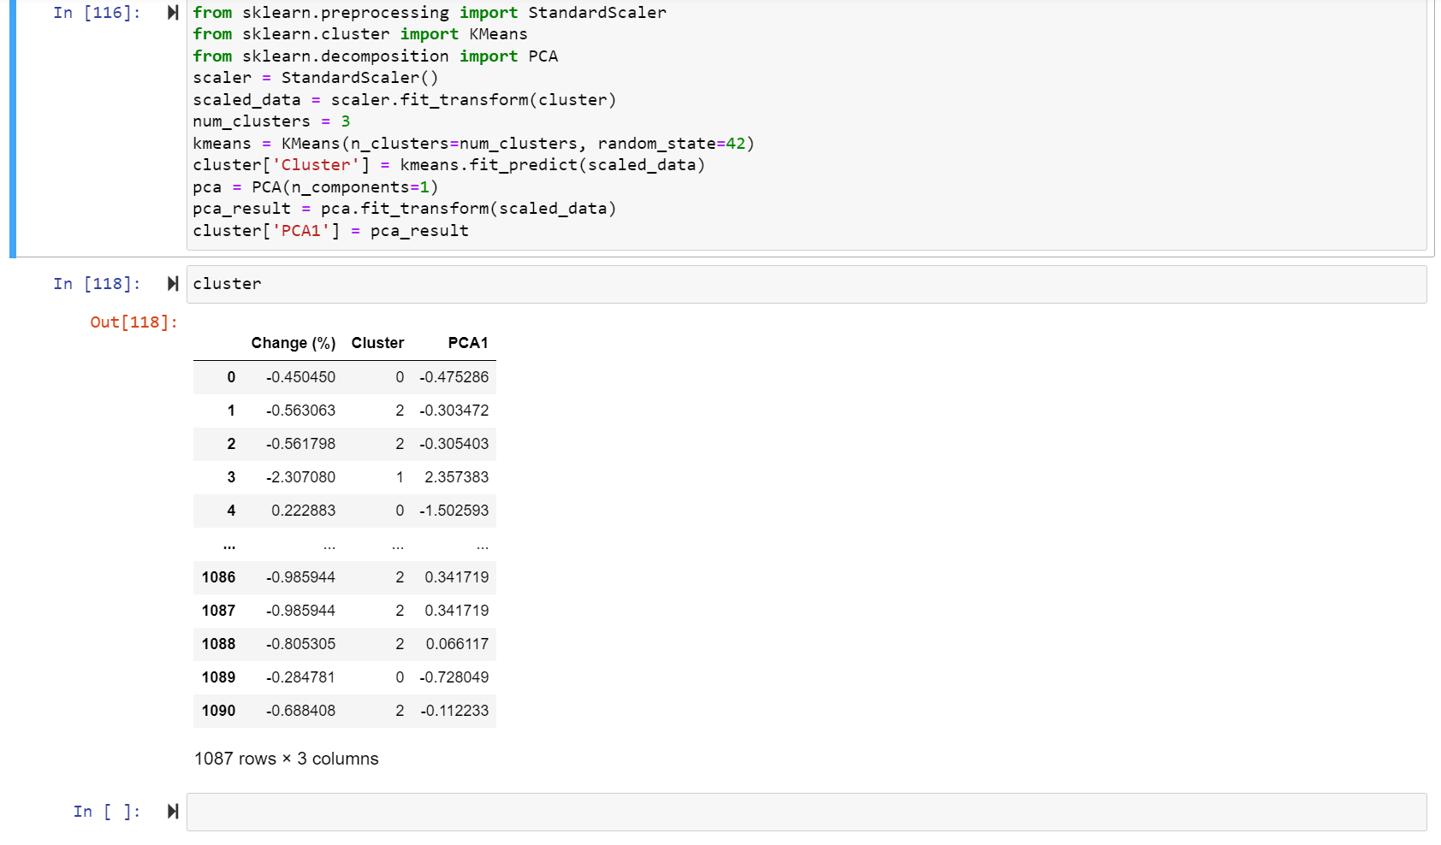
Screenshots of Activities

Slide 7

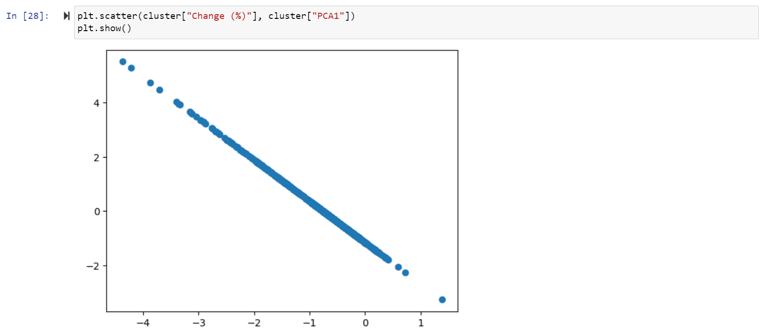

Screenshots of Activities

Slide 8

Communication
We had a phone conversation regarding the project progress and how we are going to proceed.

Slide 9

Activities to be completed before next week
Starting to design and implement visualization.

Slide 10

Thank You Any Questions?

